Slide 1

Deep RL for Network Design in Marine Transportation
Timothé Boulet
Internship period : 9 August 2022 – 31 January 2023
Supervisor : Ciprian Stirbu

Slide 2
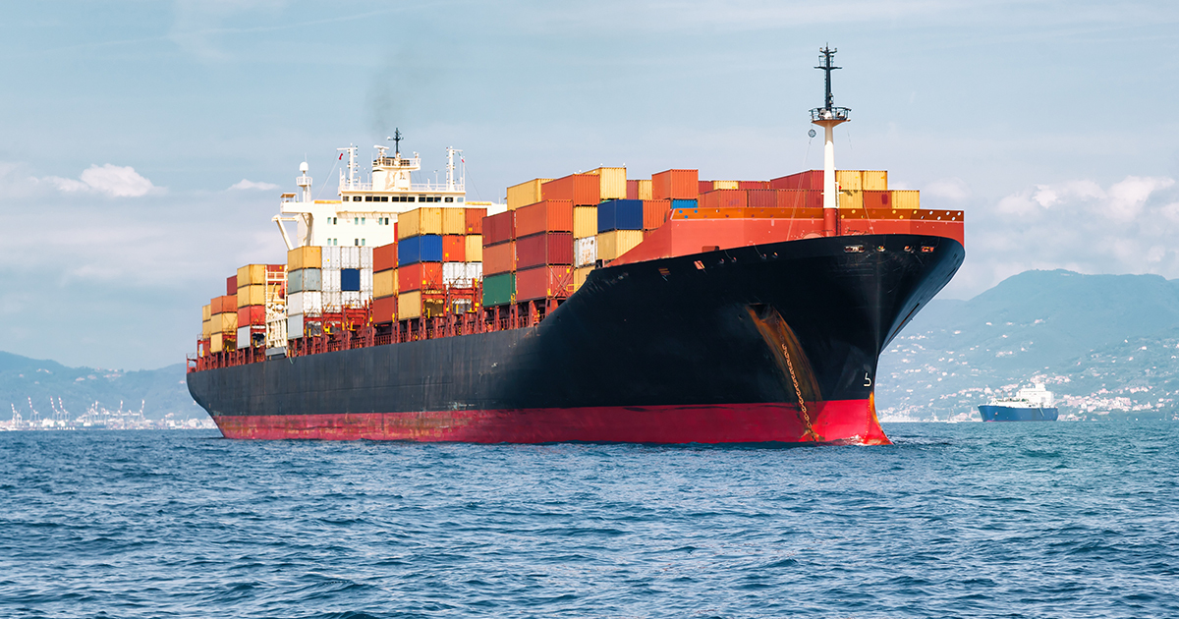
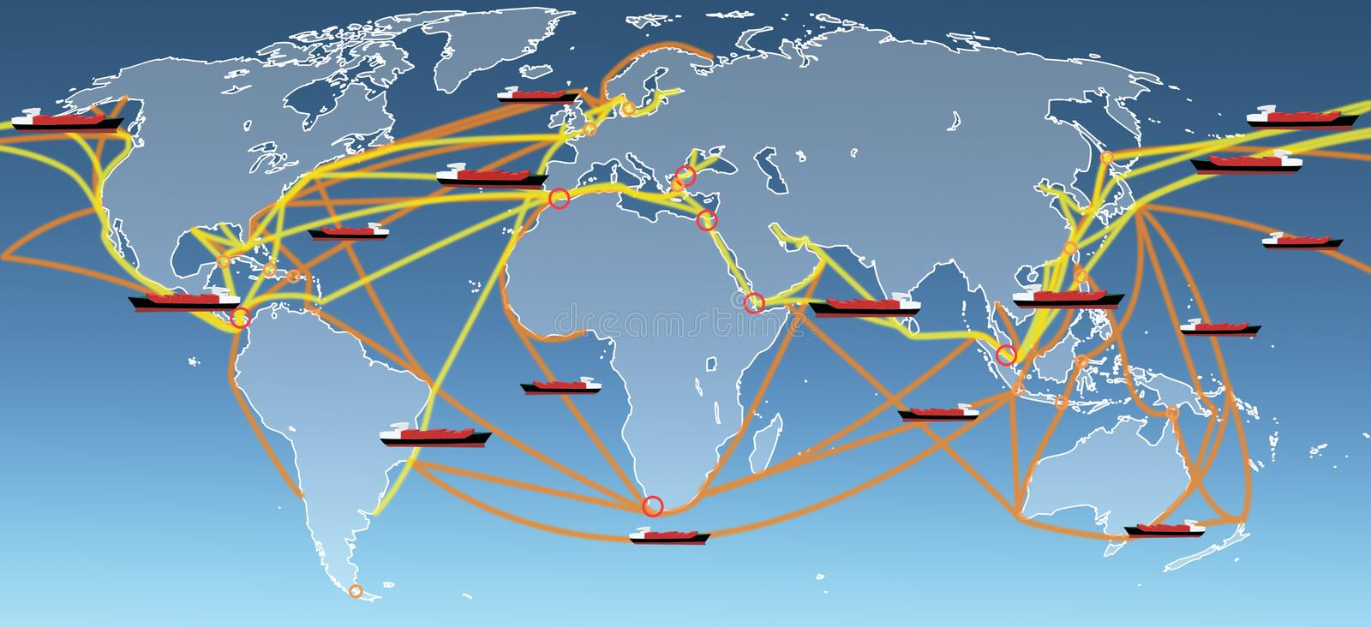
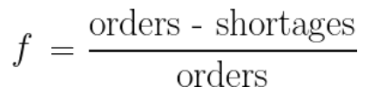
General objective :
There are orders of goods between ports that must be fullfilled, which requires :
First, vessels traveling maritime routes
Second, empty containers to hold these goods

Slide 3
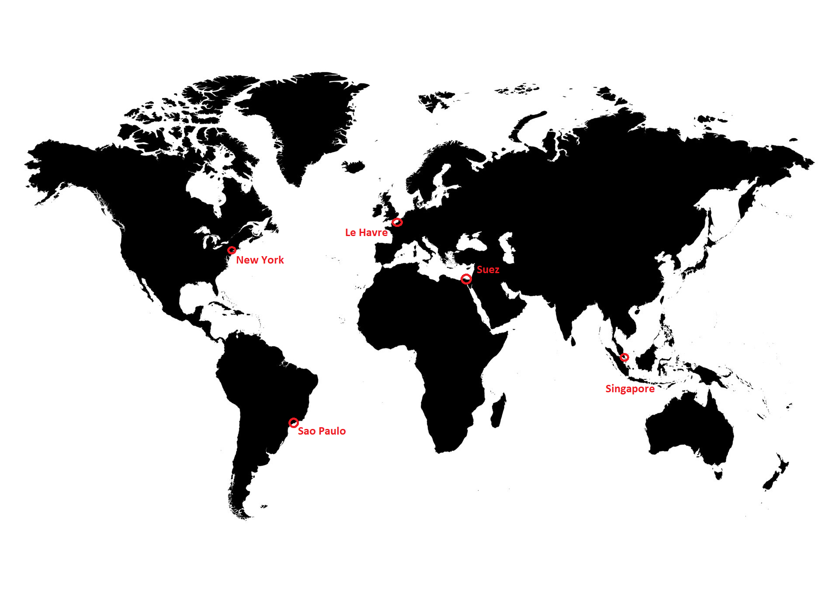
Marine Transportation optimization problems :
Network Design : Starting from a set of ports, how do I choose the routes ?

Slide 4
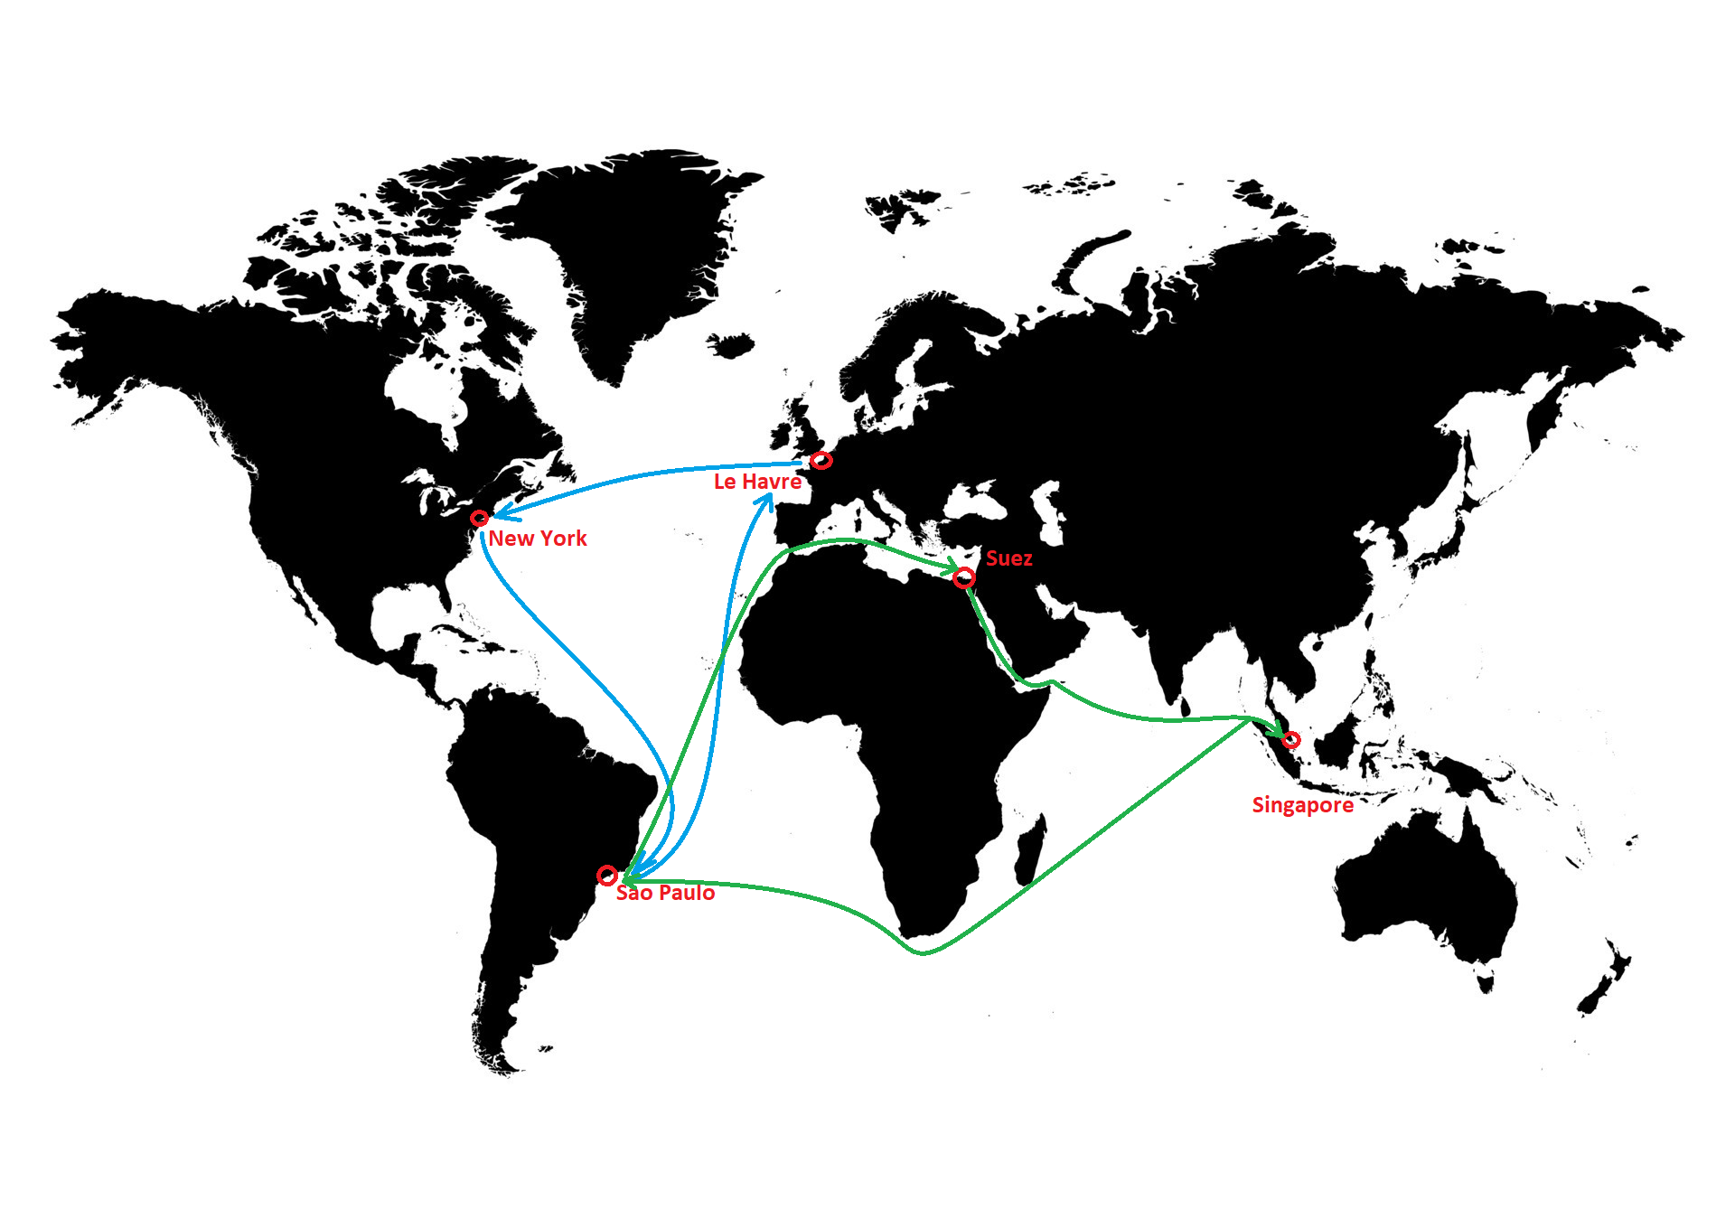
Marine Transportation optimization problems :
Network Design : Starting from a set of ports, how do I choose the routes ?

Slide 5
Marine Transportation optimization problems :
Network Design : Starting from a set of ports, how do I choose the routes ?
Fleet Deployment : starting from a network of routes, how do I assign my vessels ?

Slide 6
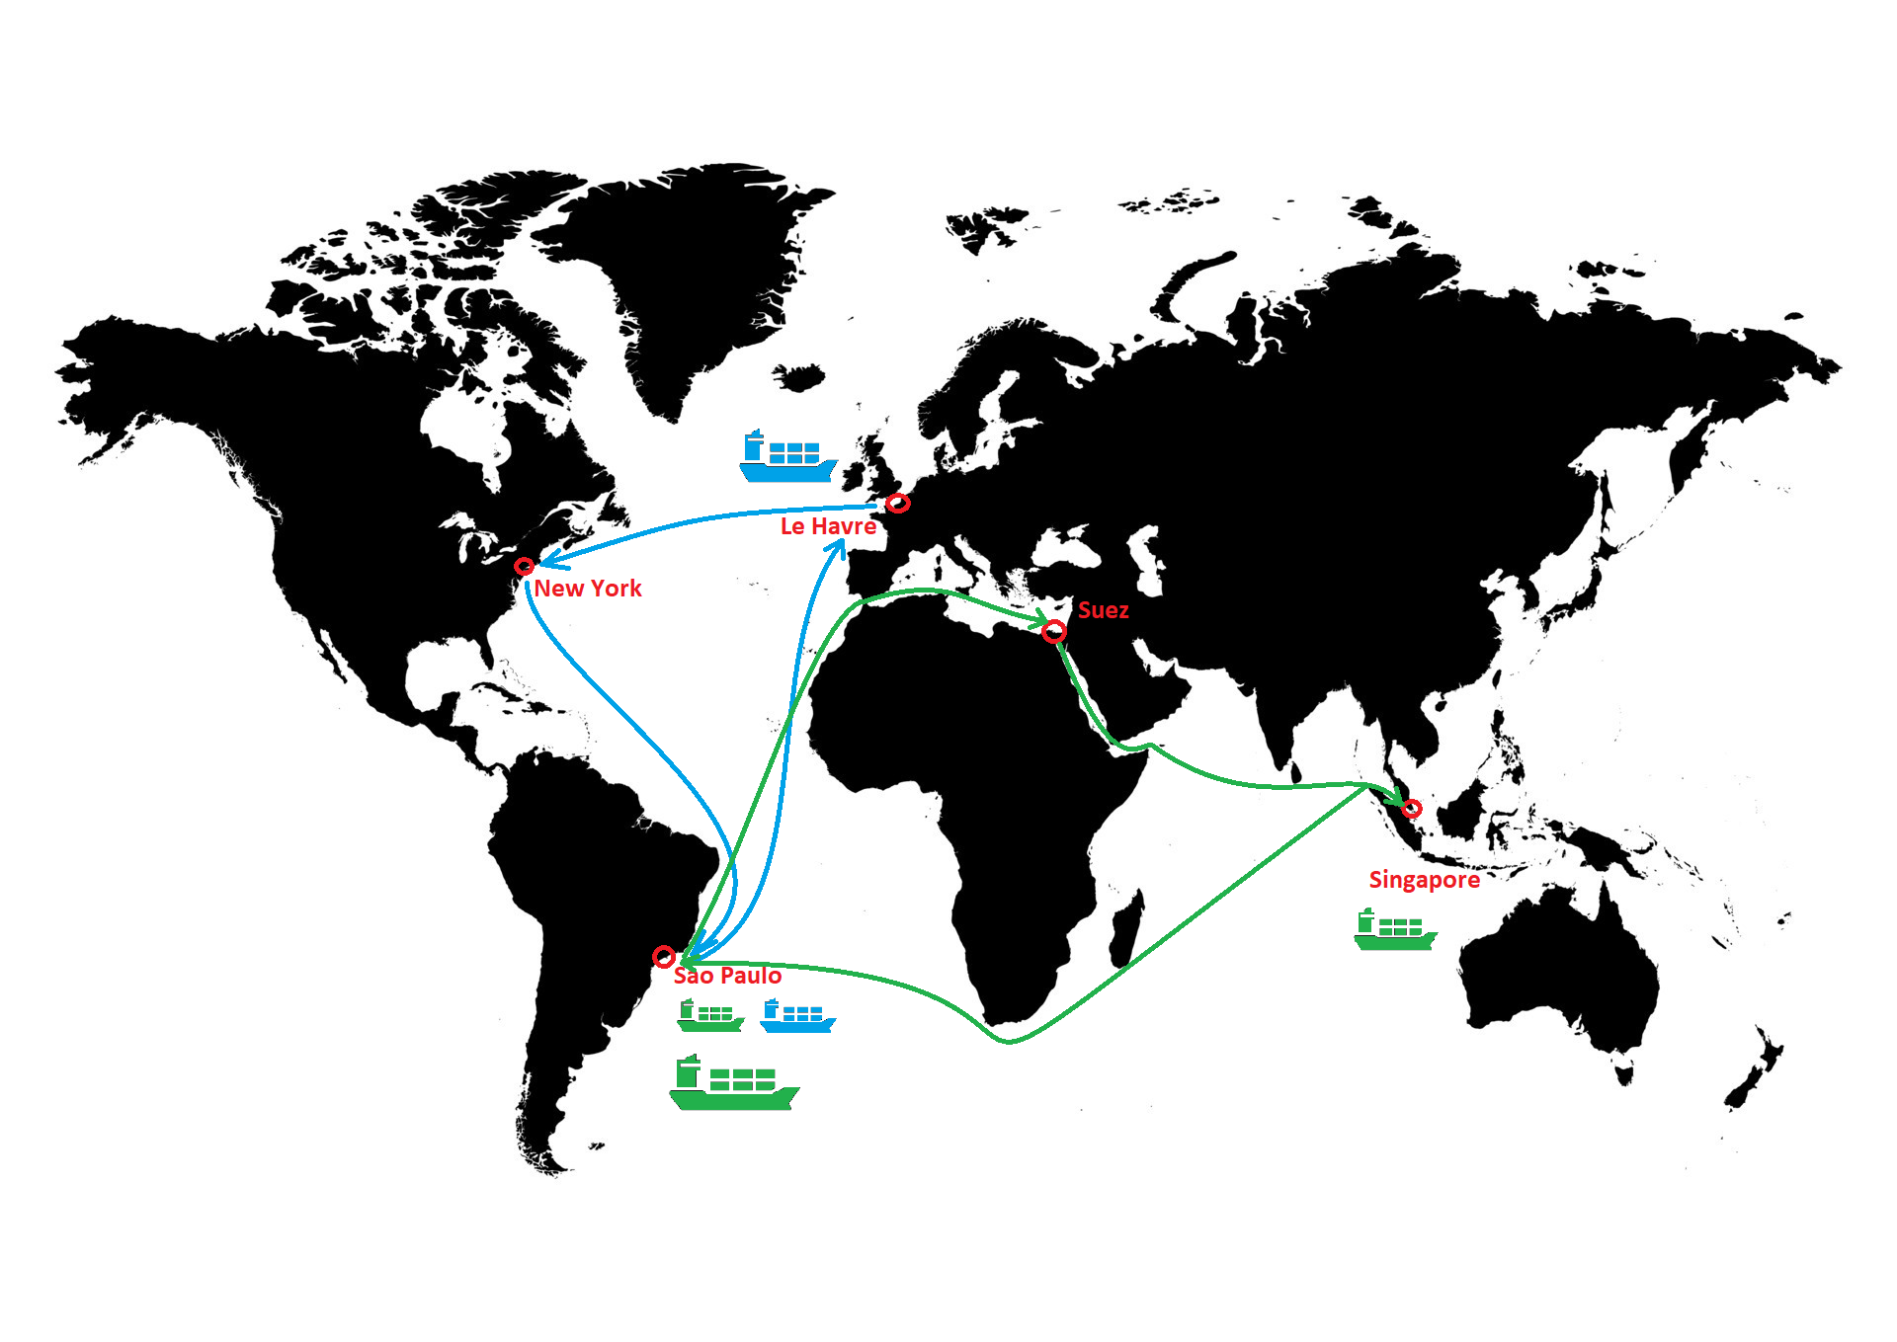
Marine Transportation optimization problems :
Network Design : Starting from a set of ports, how do I choose the routes ?
Fleet Deployment : starting from a network of routes, how do I assign my vessels ?

Slide 7
Marine Transportation optimization problems :
Network Design : Starting from a set of ports, how do I choose the routes ?
Fleet Deployment : starting from a network of routes, how do I assign my vessels ?
Empty Container Repositioning: starting from a network of assigned vessels, what strategy do I choose for my vessels ?

Slide 8
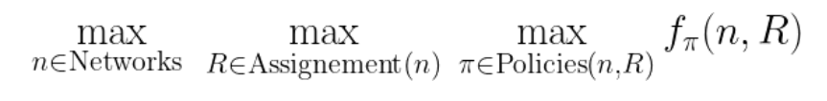
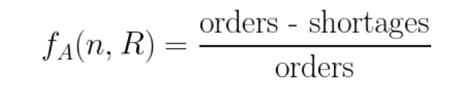
A 3-stage optimization problem :
Where “shortages” are the shortages obtained on network n with assignment R and with ECR strategy A.

Slide 9
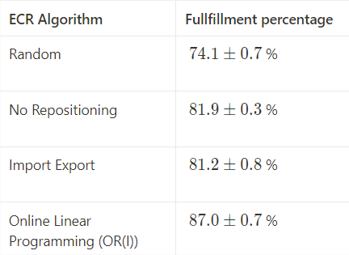
Empty Container Repositioning :
How many empty containers do my vessels load/discharge when arriving to a port ? Possible strategies :
No Repositioning
Random repositioning
Import Export : load or discharge depending on the status of the port (exporting port or importing port)
Operational Research methods : OR (offline) and ORI (online)
Multi-agent RL

Slide 10

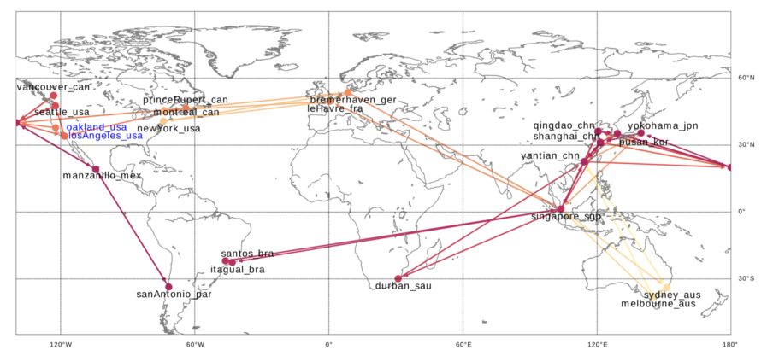
The simulator we used :
The WTT1 topology :
22 ports
46 vessels
13 routes

Slide 11
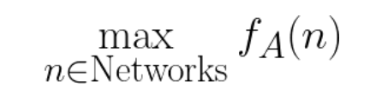
The ND+FD problem :
3 stage optimization problem
The ND+FD approach :
We build routes and assign vessels at the same time : one route for each vessel
We don’t optimize at the ECR level, we rather always use the same ECR algorithm (e.g. random)
Black-box optimization problem

Slide 12
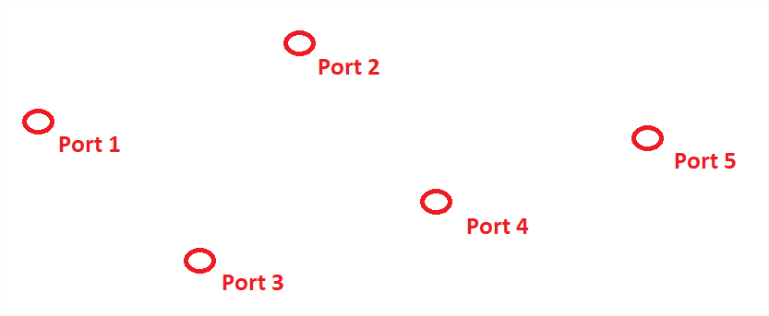
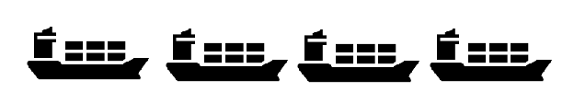
The ND+FD problem :
network
set of ports
fleet
Can be treated with any metaheuristic (Genetic Algorithm, Tabu Search, RL)
The choice for the ECR algorithm A : - Fast enough to quicly run the metaheuristic algorithm - Good enough to give a correct signal
Configure & Conquer (CC) approach : - Use a fast (but imperfect) algorithm Ac as the signal - Use a performant (but slow) algorithm Ae as the evaluation

Slide 13
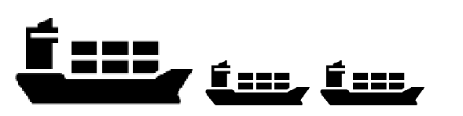
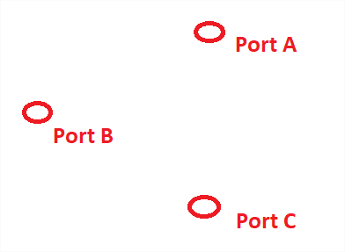
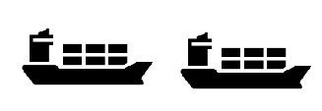
Reinforcement Learning for Network Design, why ?
Able to train on the general problem, and then instantly deployed
By building the network sequentially, it scales extremely well with the size of the problem
Constraints are easy to implement using action masking
network
network
network

Slide 14
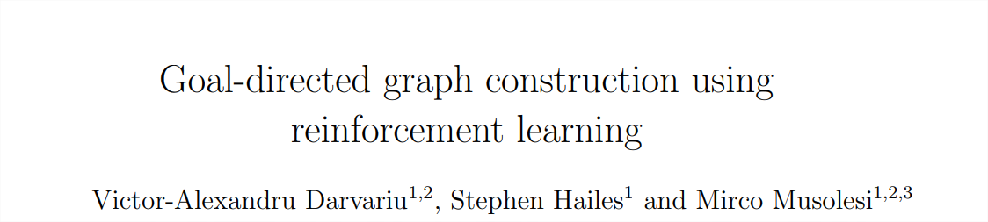
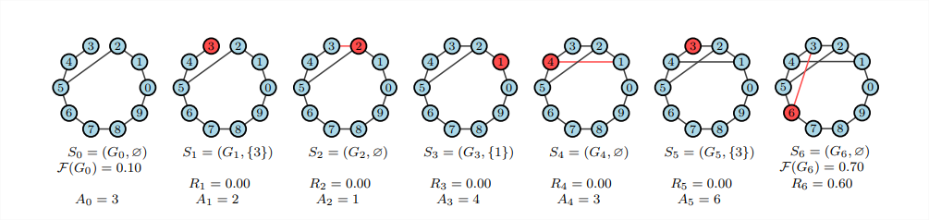
The RL environnement : the idea
Goal directed graph construction : https://arxiv.org/abs/2001.11279

Slide 15
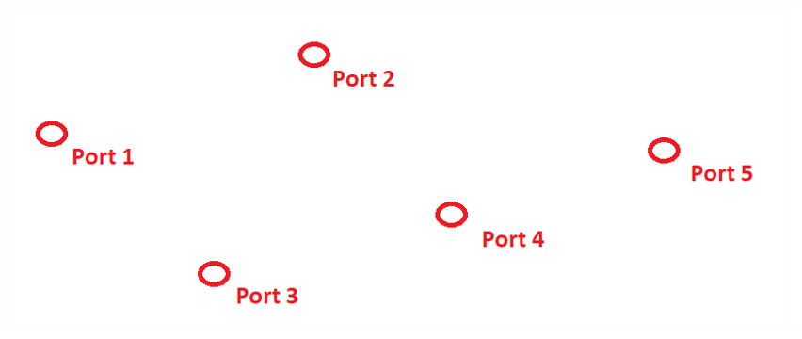
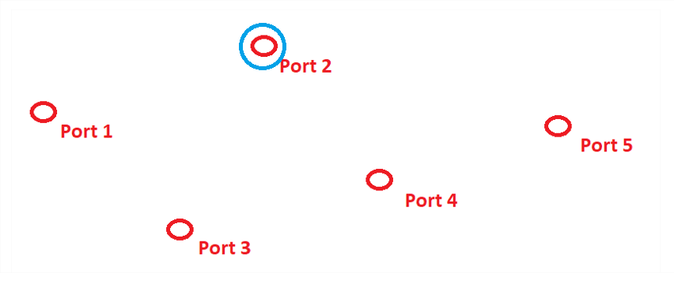
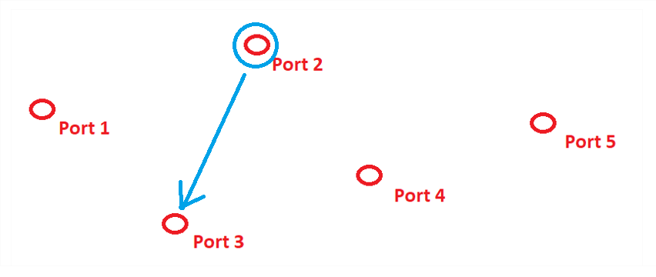
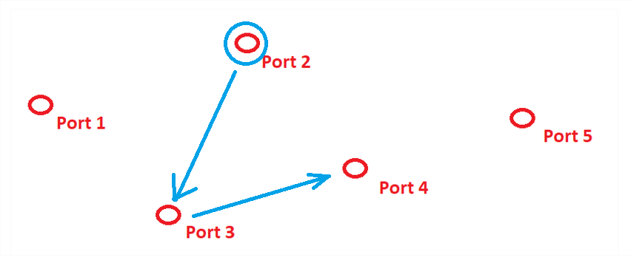
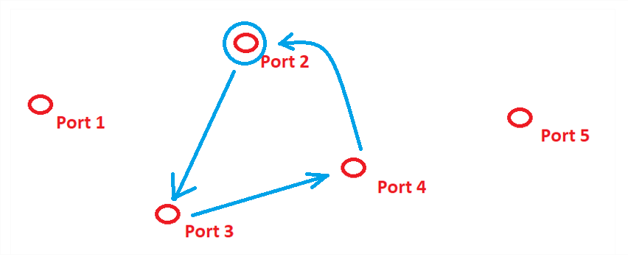
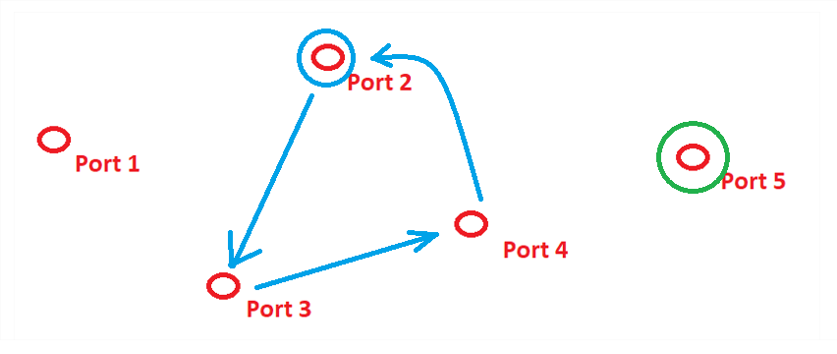










The RL environnement : transitions
$$s_{0}$$
$$s_{1}$$
$$s_{2}$$
$$a_{0}$$
$$a_{1}$$
current vessel
$$s_{3}$$
$$s_{4}$$
$$s_{5}$$
$$a_{3}$$
$$a_{4}$$

Slide 16
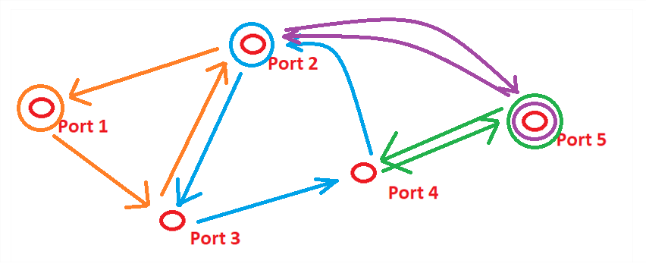



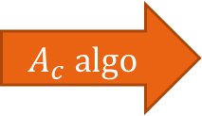
The RL environnement : termination
$$s_{T}$$
$$a_{T−1}$$
$$A_{c} \text{algo}$$
$$\text{reward} r_{T}$$
The episode terminates when all vessels are assigned (all individual routes are built)

Slide 17
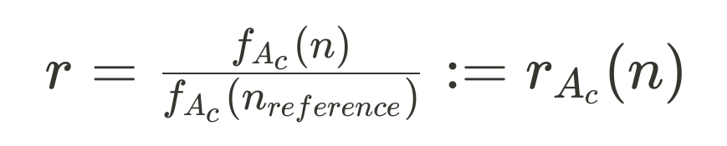
The RL environnement : reward
Normalization by expert’s reward :
Reward = 1 means the agent generates networks as good as expert networks
Goal : reach $r≈1$

Slide 18
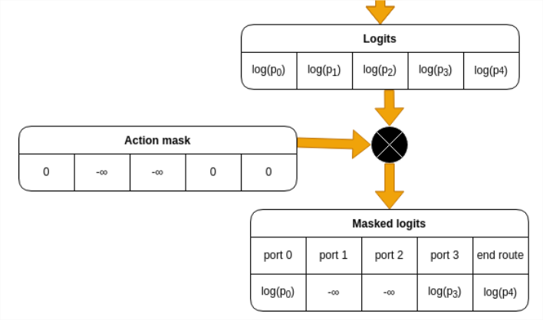
The RL environnement : actions
Action : choose the next port for the current vessel
$n_{ports}$ +1 actions : the last one is the « ending route » action
Masking actions :
Ports already in the current route
End-route action at the beginning of the route

Slide 19
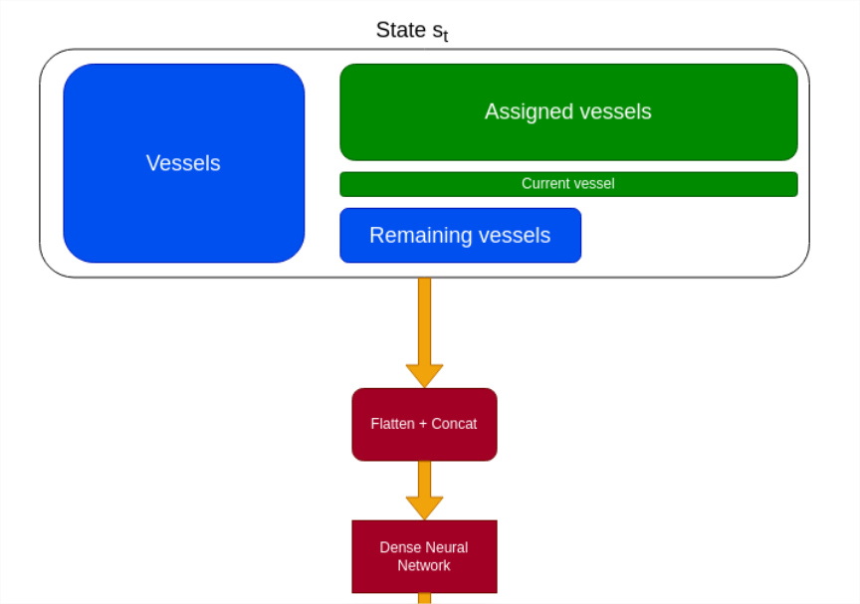
The RL environnement : observations
Each unassigned vessel :
Vessel features
Each assigned vessel :
Vessel features
Adjacency matrix
Starting port

Slide 20
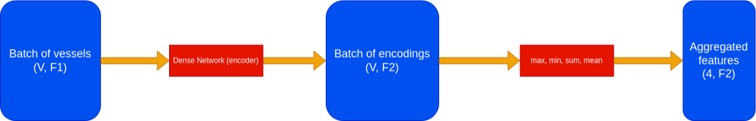
Dealing with size changing observation features
Examples :
The remaining vessels
The assigned vessels
The vessels (if non constant fleet)
Requirements :
Size agnostic
Permutation invariant

Slide 21

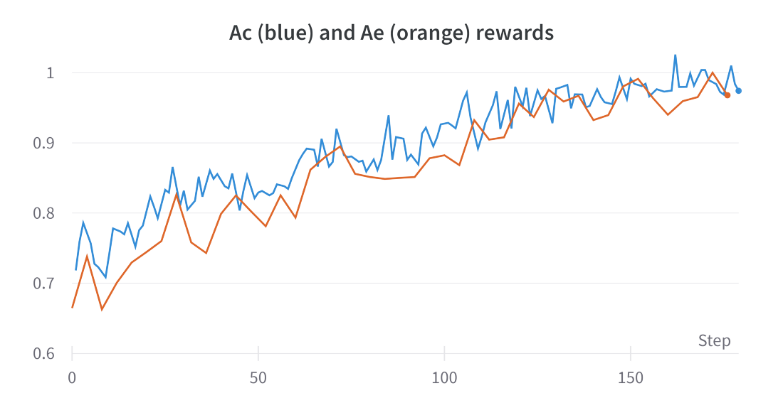



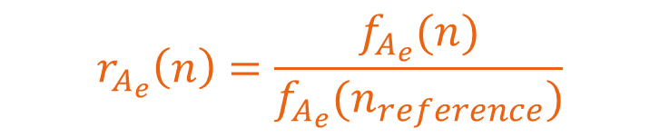
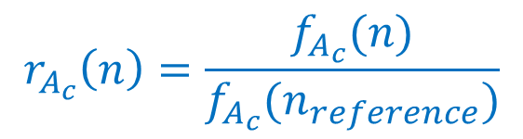
Experimental results :
Ac = random
Ae = ORI
$$r_{A_{c}}\left(n\right)=\frac{f_{A_{c}}(n)}{f_{A_{c}}(n_{reference})}$$
$$r_{A_{e}}\left(n\right)=\frac{f_{A_{e}}(n)}{f_{A_{e}}(n_{reference})}$$

Slide 22
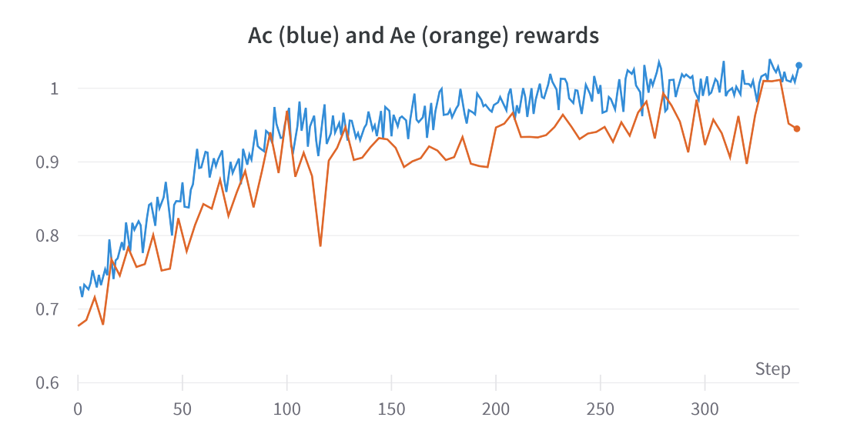
Experimental results :
Ac = random
Ae = Import Export
$$r_{A_{c}}\left(n\right)=\frac{f_{A_{c}}(n)}{f_{A_{c}}(n_{reference})}$$
$$r_{A_{e}}\left(n\right)=\frac{f_{A_{e}}(n)}{f_{A_{e}}(n_{reference})}$$

Slide 23
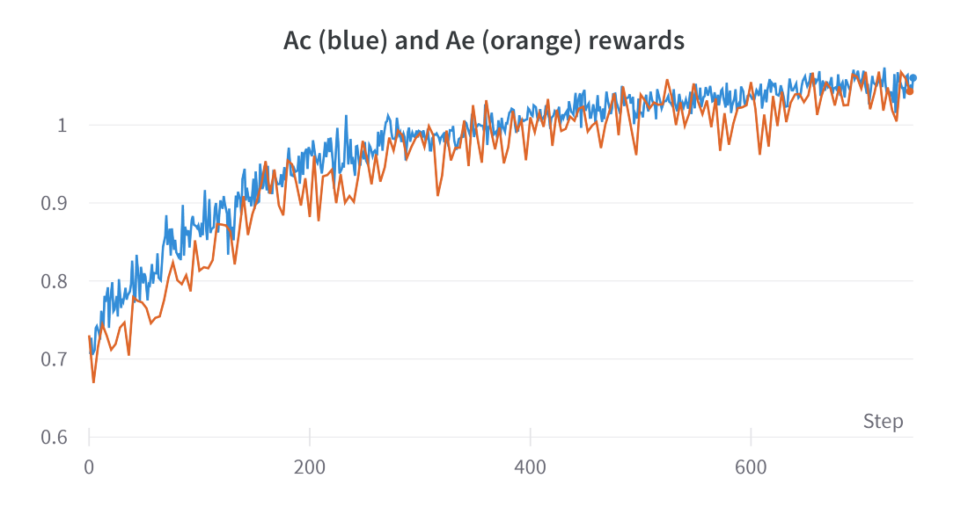
Experimental results :
Ac = no repositioning
Ae = Import Export
$$r_{A_{c}}\left(n\right)=\frac{f_{A_{c}}(n)}{f_{A_{c}}(n_{reference})}$$
$$r_{A_{e}}\left(n\right)=\frac{f_{A_{e}}(n)}{f_{A_{e}}(n_{reference})}$$

Slide 24
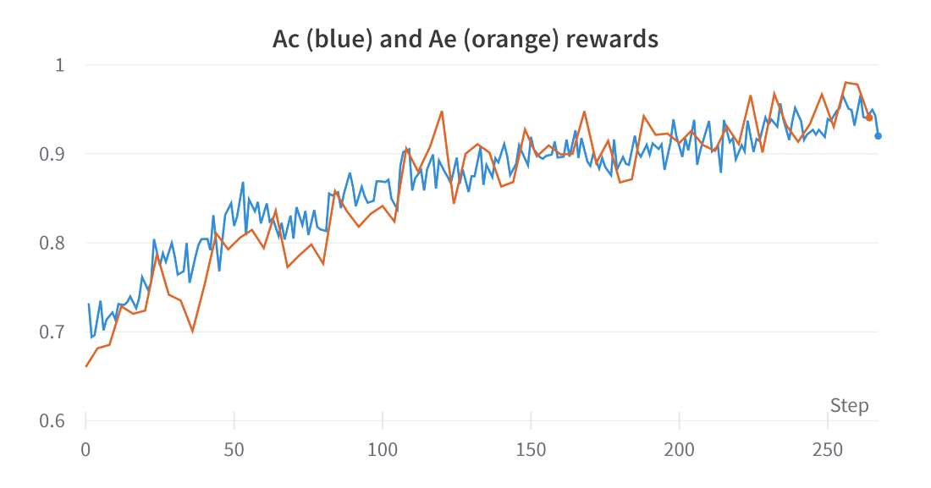
Experimental results :
Ac = no repositioning
Ae = ORI
$$r_{A_{c}}\left(n\right)=\frac{f_{A_{c}}(n)}{f_{A_{c}}(n_{reference})}$$
$$r_{A_{e}}\left(n\right)=\frac{f_{A_{e}}(n)}{f_{A_{e}}(n_{reference})}$$

Slide 25
Conclusions :
RL can be used for black-box constrained optimization problems
RL works well for Network Design
Ae can be optimized even using Ac as the signal
Next steps :
Reach higher rewards ?
Implement a metaheuristic for ND+FD (better baseline than the expert baseline)
Use more advanced architectures : Transformers, GNN
Generalize to non-constant fleet, and even non-constant set of ports

Slide 26

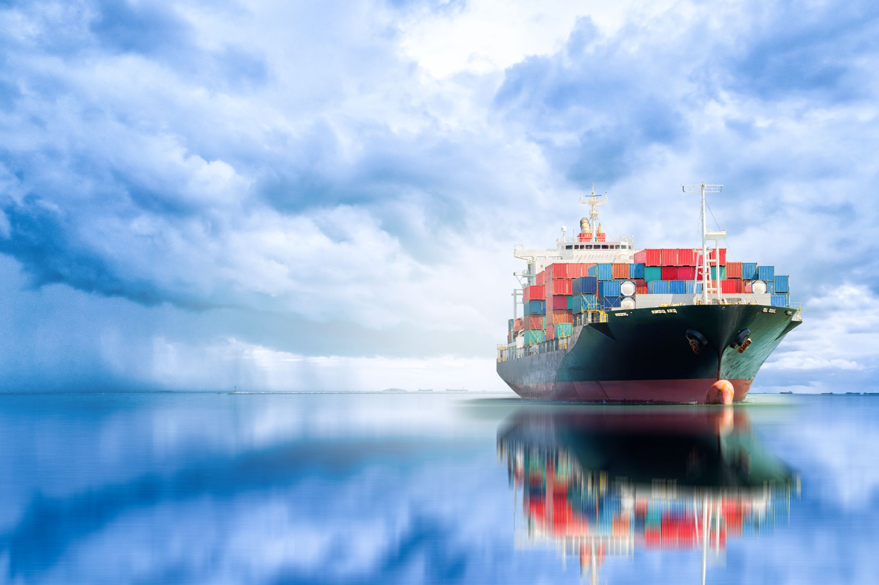
Deep RL for Network Design in Marine Transportation
Questions ?

